Slide 1

-Vivek Kantariya (09BCE020)
-Nayan Khanpara (09BCE021)

Slide 2
Outline
Introduction
History
Features
Advantages
Setup
Working

Slide 3
Introduction
Dropbox is a Web-based file hosting service operated by Dropbox.Inc. that uses cloud computing to enable users to store and share files and folders with others across the Internet using file synchronization.
Today, more than 25 million people across every continent use Dropbox to always have their stuff at hand, share with family and friends, and work on team projects.

Slide 4
Introduction(conti..)
No advertising spend
Hostile environment, lots of competitors, software download
Mostly done by engineers w/ some guidance but no prior marketing experience

Slide 5
History
Dropbox was founded in 2007 by MIT graduates
Founder and CEOs:
Drew Houston and Arash Ferdowsi
Founded in ‘07, launched Sep ’08
Today more than 25 Million of users.

Slide 6

Dropbox Features
Mobile Devise Access
Privacy
File Sync
Security
File Sharing
Web Access
Online Backup

Slide 7

Features
2GB of Dropbox for free, with
subscriptions up to 100GB
available.
Works even when offline.
Dropbox transfers just the parts of a file that change (not the whole thing).
Dropbox works with Windows, Mac, Linux, iPad, iPhone, Android and BlackBerry.

Slide 8
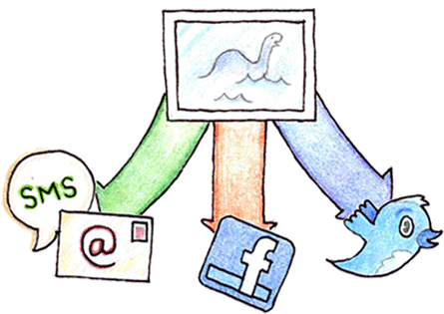
Features(conti..)
Send a link to any file in your
Dropbox using your Public folder.
keep your Dropbox at hand, even on the go.
Edit files in your Dropbox from your phone.
Easily upload your photos and videos to Dropbox.
Invite friends, family or teammates to a folder. It'll be as if you saved the folder to their computers.

Slide 9
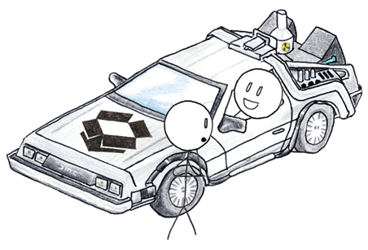
Features(conti..)
Dropbox keeps a one-month
history of your work.
Any changes can be undone, and files can be undeleted.
Secure Sockets Layer (SSL) and AES-256 bit encryption.

Slide 10
Advantages:-
Unlimited file revisions (unsure if they keep this for free)
Incremental (delta) file upload
Has client software for Windows, Mac and Linux
Easy to restore deleted folders
Disadvantages:-
Syncs one folder (but they're working on that)
Renamed files are treated like new files (new revision, old file deleted)

Slide 11
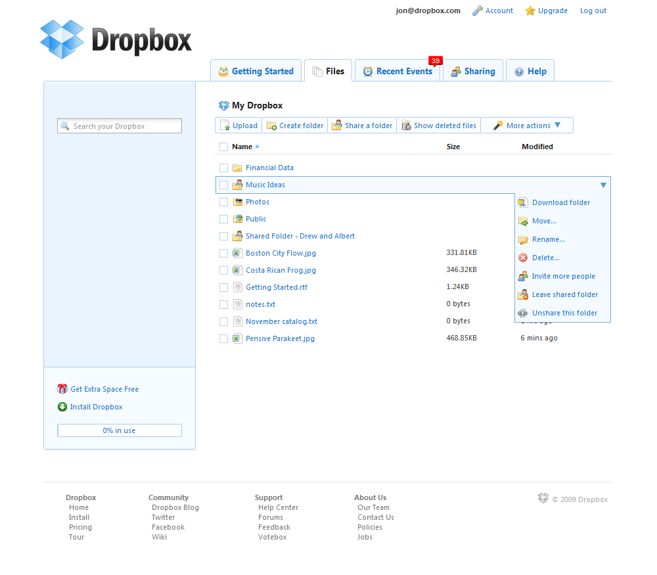
Setup

Slide 12
Internal working
Both the Dropbox server and desktop client software are primarily written in Python.
The software does not use any third-party file sync or version control libraries.
The Dropbox client enables users to drop any file into a designated folder that is then synced with Drop box's Internet service.
focusing on synchronization and sharing

Slide 13
Storage of data
When we upload any data to Dropbox , that is going to be stored in server of Dropbox company.
We can define our data to private or public , that we want to share our data to other person or not.
We can provide our friends or partners to use our data by giving them link to our Dropbox.

Slide 14
Storage of data(conti..)
As they got a link to our Dropbox , they can see our data & they can also download it if they required.
To download data from Dropbox , they must need to connect to Dropbox web server.
If file is already available on client machine , not the whole file is transferred , but the only part that is modified is going to transferred.

Slide 15
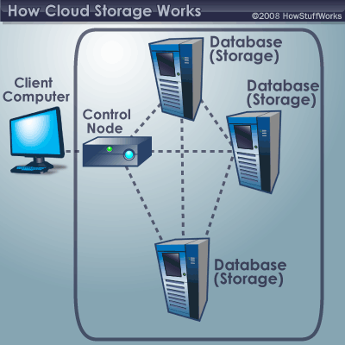
Cloud Storage

Slide 16
Cloud Storage(conti..)
A client (e.g., a computer user subscribing to a cloud storage service) sends copies of files over the Internet to the data server, which then records the information.
When the client wishes to retrieve the information, he or she accesses the data server through a Web-based interface.

Slide 17
Cloud Storage(conti..)
The server then either sends the files back to the client or allows the client to access and manipulate the files on the server itself.
The two biggest concerns about cloud storage are reliability and security.

Slide 18
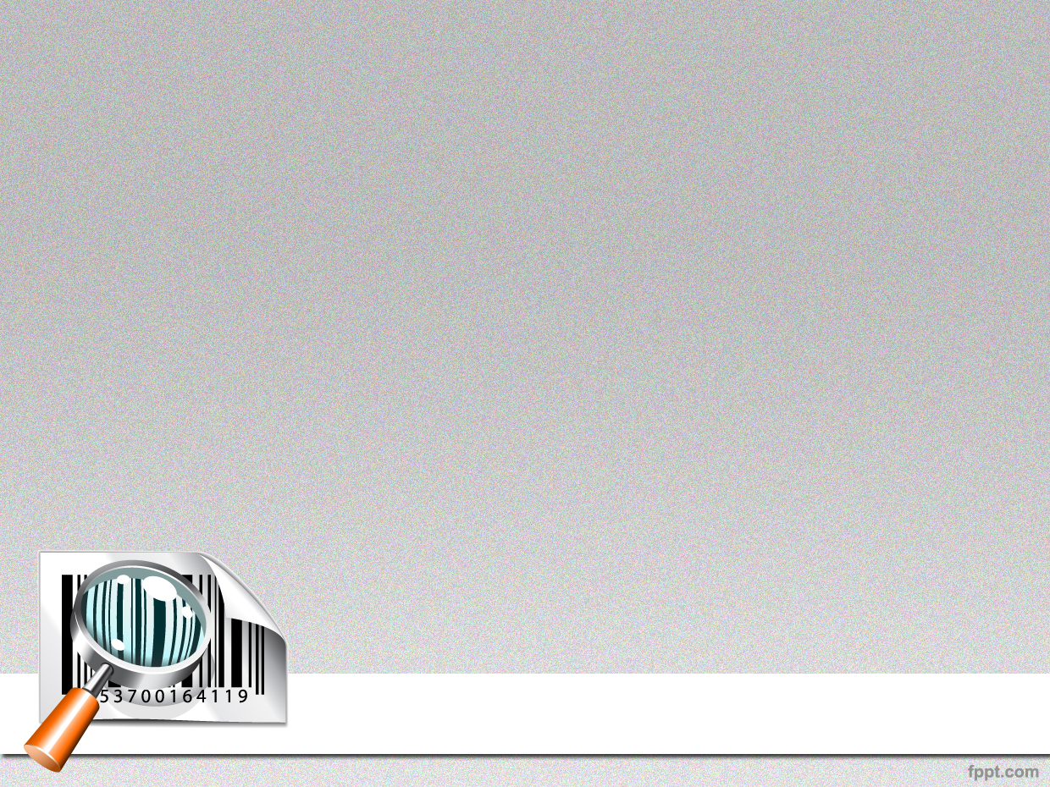
Q ??

Slide 19

Thank You

